Slide 1
Data Analysis Specialist
Project Title: Real Estate Sales Data Analysis Presenter's Name: Adham Osama, Ahmed Adel, Ahmed Anwar, Shawkat Gamal Date: 10/21/2024

Slide 2
Project Idea
1- Problem: Analyzing real estate sales performance over four years (2020–2024) to understand trends, targets, and commissions for each sales rep. 2- Solution: We processed the company's sales data using SQL, Python, and Excel to calculate key metrics like sales performance, commission, and target achievements. 3- Unique Value Proposition: Comprehensive analysis of four years' worth of real estate data, offering insights on sales performance by region, city, and individual rep, visualized in a dynamic Tableau dashboard.

Slide 3
Project Wireframe
1- Visuals: Charts and dashboards showing sales by region, rep performance, commission breakdowns, and target achievements. 2- User Journey: Data collection, cleaning, and analysis using SQL and Python, with final visualization in Tableau for easy monitoring of sales trends. 3- Focus: Usability and a clear user experience, allowing decision-makers to track real estate sales performance at a glance.

Slide 4
End Users + Features
End Users: Real estate companies, sales managers, and analysts. Key Features: 1- Breakdown of sales by region and individual rep. 2- Commission calculations per sale. 3- Target achievement tracking and performance analysis. User Problem Solving: Helps businesses assess sales reps' performance, track commissions, and set future targets based on past performance.

Slide 5
Data Structure
Database Architecture: CSV files used for data storage and processed through SQL and Python . Key Entities: Companies, regions, sales reps, unit types, sales amounts, commissions, and sale dates. Data Flow:
Steps Taken: Data imported, cleaned, missing values handled, types converted, commissions calculated, and targets set . Summary: Final summaries and visualizations created in Tableau.

Slide 6
Programming Languages + Frameworks
1- Languages: SQL, Python, Excel.
2- Frameworks/Tools: Tableau for data visualization. 3-Supporting Technologies: CSV files for data input, Python for analysis, SQL for aggregation.

Slide 7
Live Application
Current State: Tableau dashboard displaying real-time sales performance, target achievements, and growth forecasts, with charts for each state and rep . Key Visuals: Sales by state, sales by rep, commissions, and performance metrics.

Slide 8
Deliverables
Reports: 1- Sales summaries by region and rep. 2- Performance charts and commission breakdowns. 3- Detailed reports on sales targets and achievements. Other Products: Source code for SQL and Python scripts, Tableau dashboard link.

Slide 9
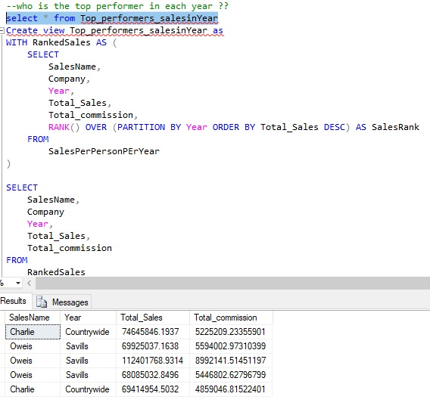
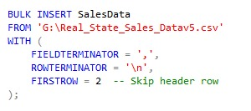
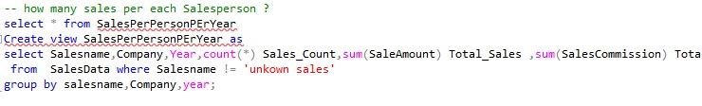
Project Documentation
SQL

Slide 10
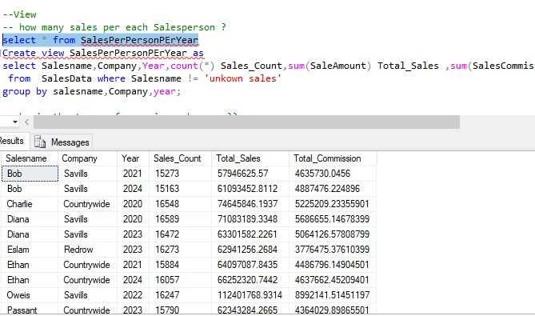
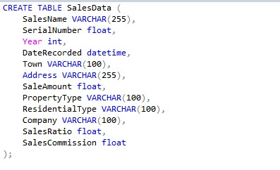
Project Documentation
SQL

Slide 11
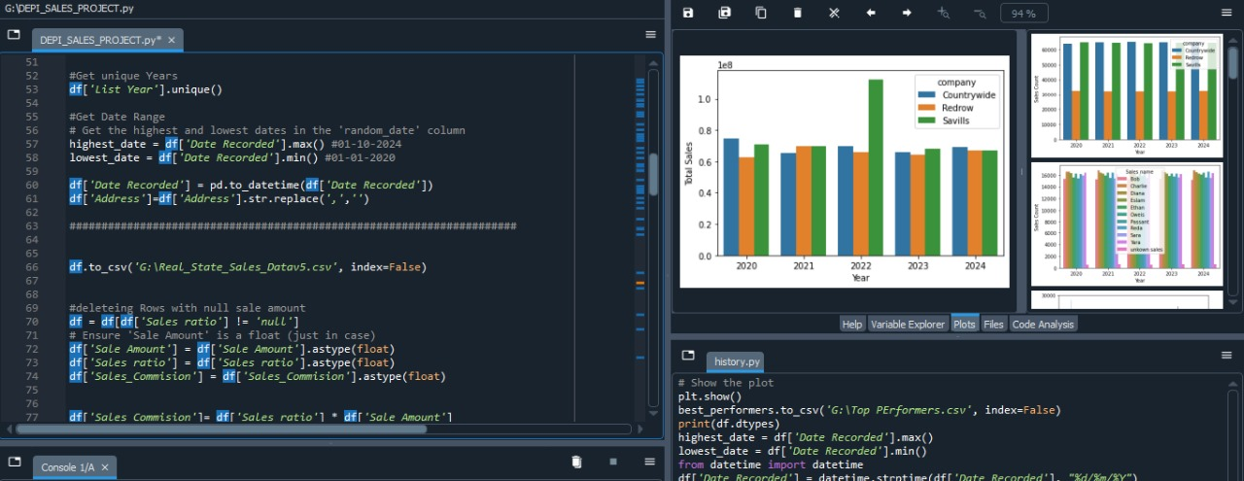
Project Documentation
Python

Slide 12
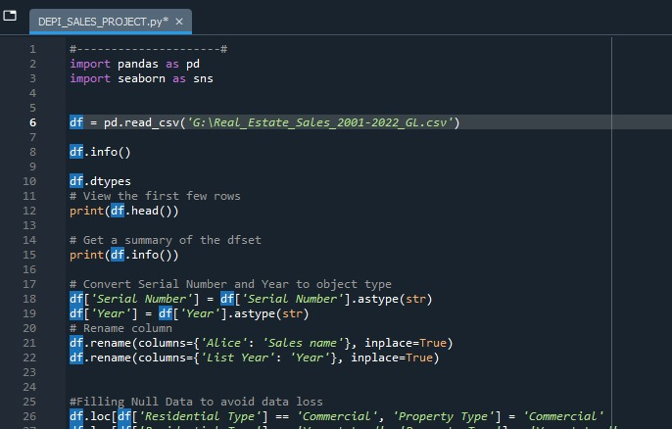
Project Documentation
Python

Slide 13
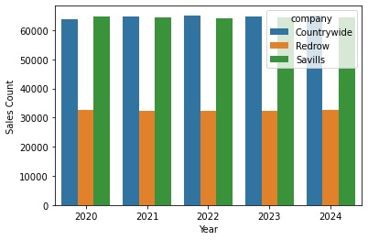
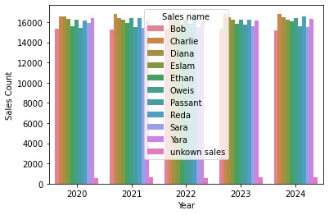
Project Documentation
Python

Slide 14
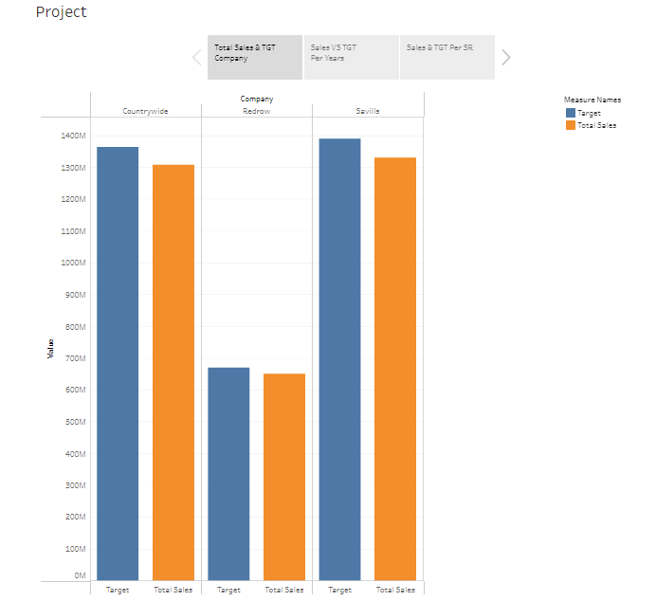
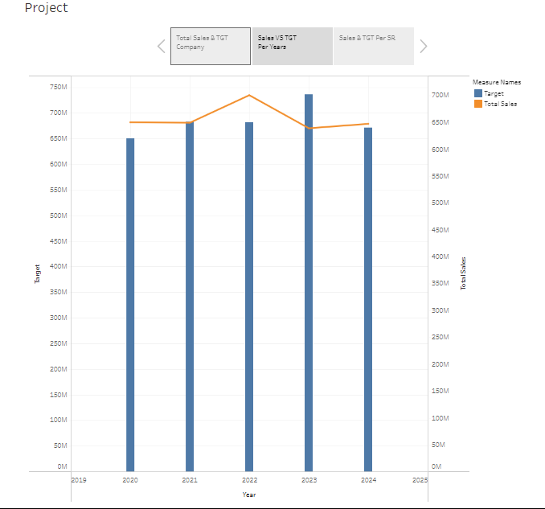
Tableau
Project Documentation

Slide 15
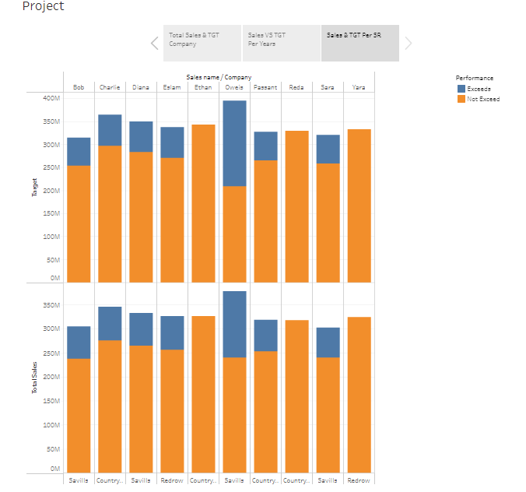
Project Documentation
Tableau

Slide 16
Project Team + Roles
Team Members: Adham Osama : Lead Data Analyst, Data Cleaning and Transformation (Python) Ahmed Adel : Data Structuring and Aggregation (SQL). Ahmed Anwar : SQL and Python Analysis. Shawkat Gamal : Visualization and Reporting (Tableau). Project Pipeline: Data collection → Cleaning → Analysis → Visualization.

Slide 17
Thank You!

